Slide 1

Prompt engineering techniques

Slide 2
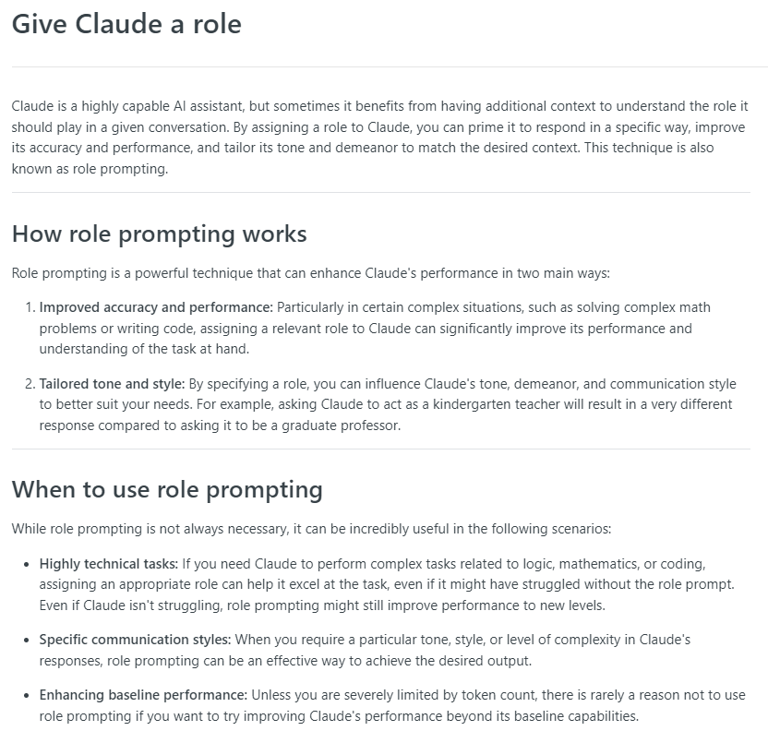
Give Claude a Role
Notes:
https://docs.anthropic.com/claude/docs/give-claude-a-role

Slide 3
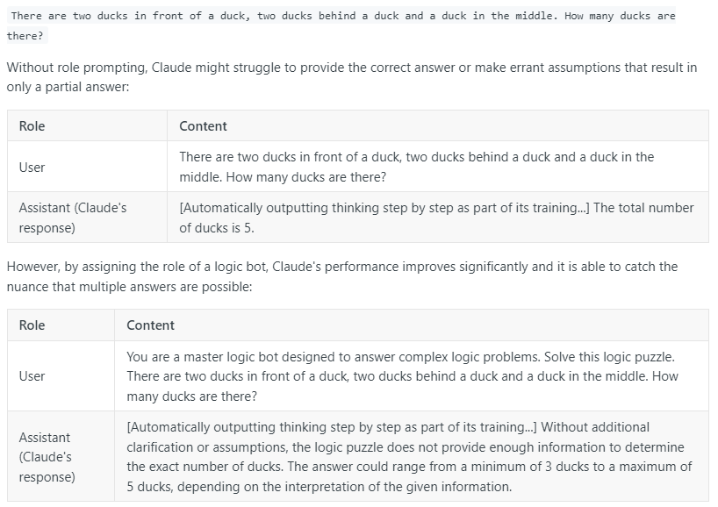
Role Example: Solving Logic Puzzles

Slide 4
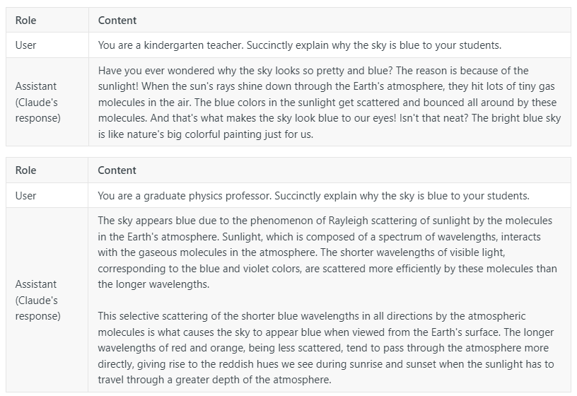
Role Example: Explaining Output to different audiences

Slide 5
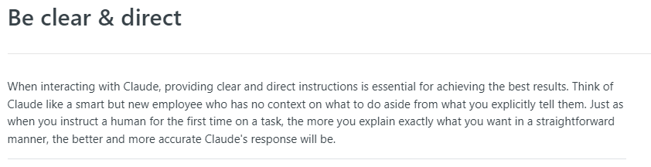
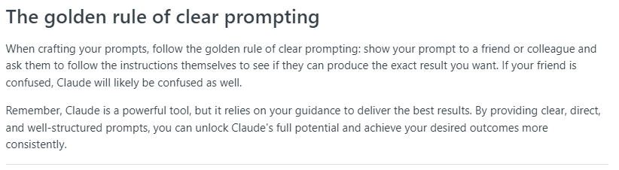
Be Clear & Direct
Notes:
https://docs.anthropic.com/claude/docs/be-clear-direct

Slide 6
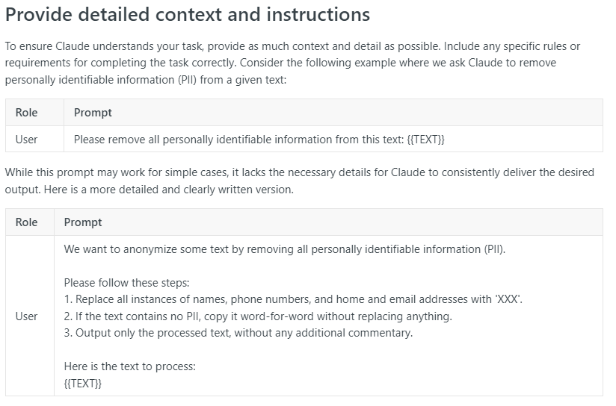
Clear & Direct: provide detailed context and instructions

Slide 7
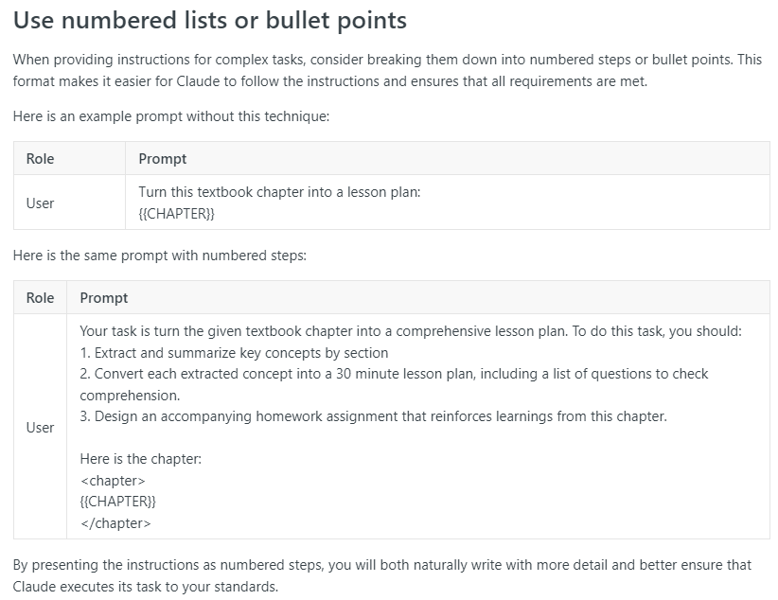
Clear & Direct: Use Numbered Lists or Bullet Points

Slide 8
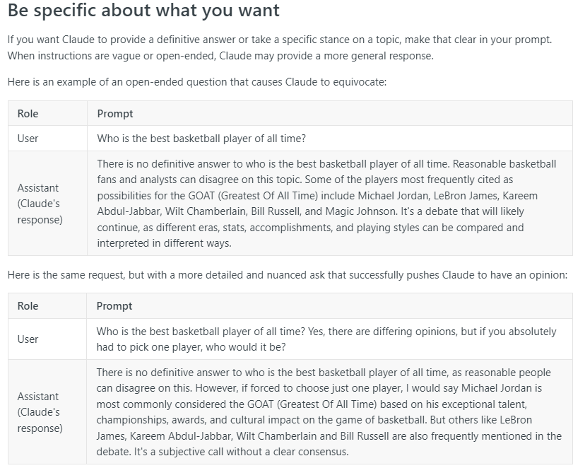
Clear & Direct: Be Specific About What You Want

Slide 9
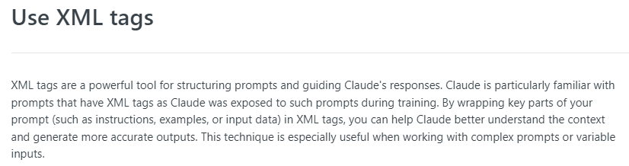
Use XML Tags
Notes:
https://docs.anthropic.com/claude/docs/use-xml-tags

Slide 10
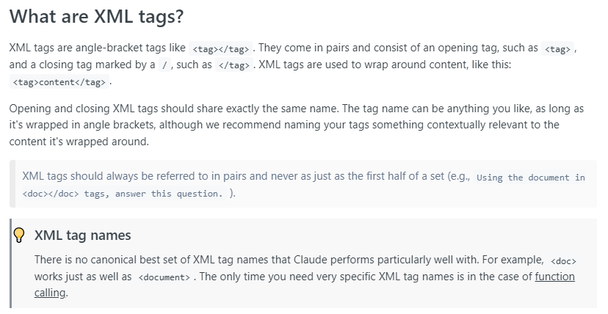
XML Tags: Tags Explained

Slide 11
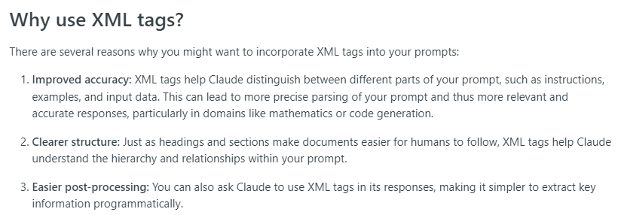
Xml Tags: Why use xml tags

Slide 12
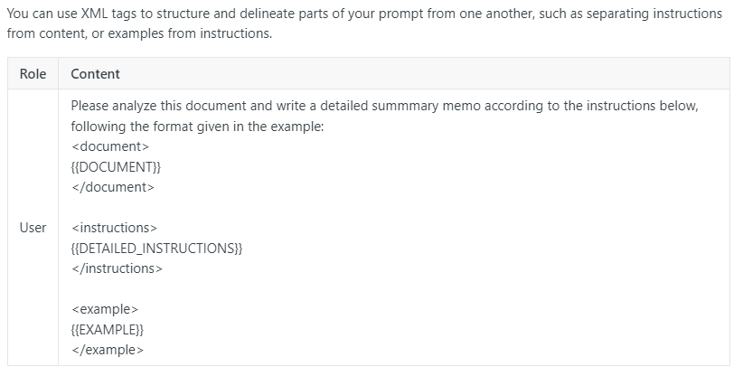
Xml Tags: How to use xml tags

Slide 13
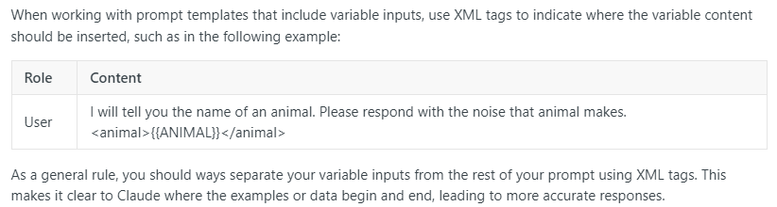
XML Tags: Variable Input

Slide 14
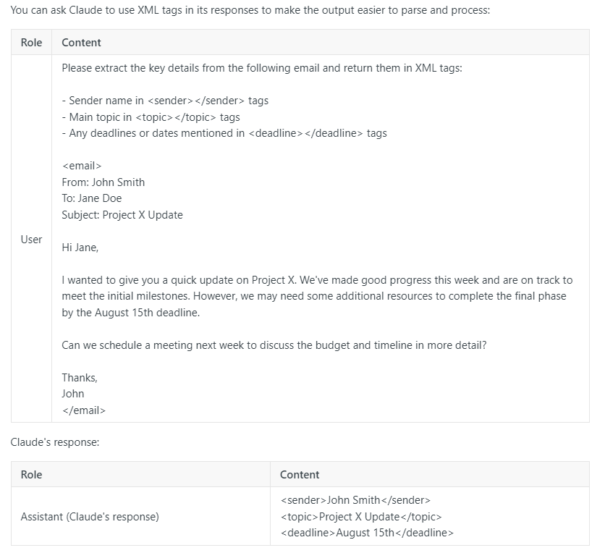
XML Tags: Structured Output

Slide 15
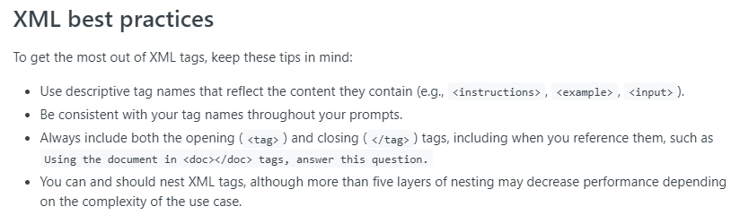
Xml Tags: Best practices

